Slide 1
CAR ACCIDENT SERVERITY PROBLEM

Slide 2
Introduction/ Business Problem
In Our Day today life, we may not experience things that happen suddenly always but things are still happening around which we don’t have control over.
One of such incidents is Car accidents and there are serval reasons for that to occur. There are cases where lives are saved with immediate action and cannot be saved also.
The project will work on different cases the accidents occur and provide a solution how it can be reduced after analyzing the reasons for the incidents.
Below Project will give the Government/ People understanding on the accidents occur in certain locations and how to prevent the accident from happening.

Slide 3
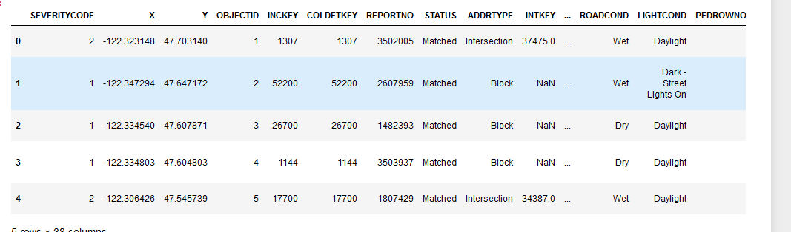
Data section
The data set will consist of inputs such as location, severity or no of accidents occurred, weather condition, road condition, period of the day and other optional inputs like road signal, traffic condition and cause of accident.
These inputs will be processed and used for the analysis purpose.
The severity will be numbered from 0-5 where 0 is least time accident occurred and 5 is the maximum value.
The weather condition will be rainy or dry.
Road condition will be normal, wet road or damaged.
And finally the period of the day will be day, noon and night which also help us understand the cause of an accident.

Slide 4
Methodology Section
K-Nearest Neighbor (KNN)
KNN will help us predict the severity code of an outcome by finding the most similar to data point within k distance.
Decision Tree
A decision tree model gives us a layout of all possible outcomes so we can fully analyze the consequences of a decision. It context, the decision tree observes all possible outcomes of different weather conditions.
Logistic Regression
Because our dataset only provides us with two severity code outcomes, our model will only predict one of those two classes. This makes our data binary, which is perfect to use with logistic regression.

Slide 5
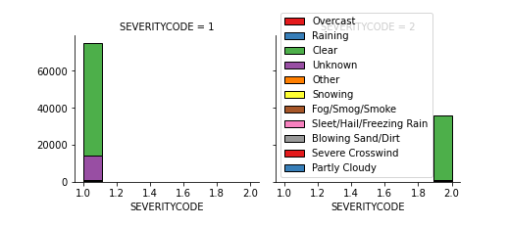
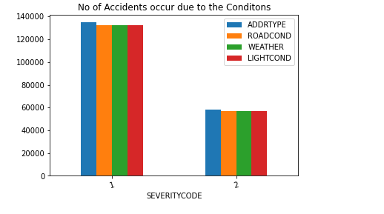
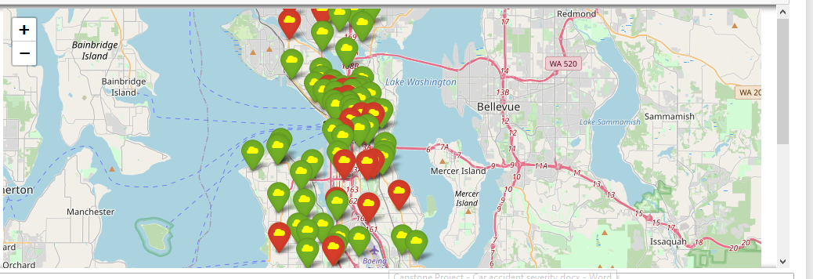
Charts and Graphs

Slide 6
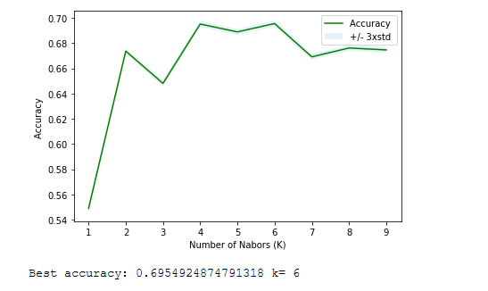
Analysis
Train/Test Split
We will use 20% of our data for testing and 80% for training.
Train set: (155738, 4) (155738,)
Test set: (38935, 4) (38935,)
K-Nearest Neighbor (KNN)
The KN Neighbor below the Highest level of Accuracy is achieved at Level 6.
Decision Tree
The Decision tree logics has been predicted with the Accuracy is Achieved at 6.9.Decision Tree Accuracy: 0.6993082428683949
Logistic Regression
The Logistic Regression Analysis shows the Highest level of Accuracy is achieved at the level 6

Slide 7
Results & Evaluation
 | KNN | Decision | LOG
F1-score | 0.60 | 0.58 | 0.5805
Jaccard Score | 0.64 | 0.70 | 0.6939
 |  |  | LogLoss: : 0.59

Slide 8
Discussion
categorical data that was of type 'object'. This is not a data type that we could have fed through an algorithm, so label encoding was used to created new classes that were of type int8; a numerical data type.
The solution to this was down sampling the majority class with sklearn's resample tool. We down sampled to match the minority class exactly with 58188 values each.
It was then fed through three ML models; K-Nearest Neighbor, Decision Tree and Logistic Regression.
Evaluation metrics used to test the accuracy of our models were jaccard index, f-1 score and logloss for logistic regression.
Choosing different k, max depth and hyparameter C values helped to improve our accuracy to be the best possible.

Slide 9
Conclusion
It conclude that particular weather conditions have a somewhat impact on whether or not travel could result in property damage (class 1) or injury (class 2).
Thank You

